Slide 1






Job Market Insights & Skill Trends Analysis
Instructor - Dr. Jongwook Woo
Group 3:
Derek Abrego
Latika Kapoor
Mitali Purohit

Slide 2

INTRODUCTION
LinkedIn is a Professional networking platform connecting individuals and businesses globally
LinkedIn has been acquired by Microsoft in December 2016 for more than $26 Billion.
LinkedIn has around 134.5 Million Daily Users.
Notes:
Derek

Slide 3
INTRODUCTION
Main Study Focus: Analyzing Job Posts Data
Objective: Examine trends in job skills, educational requirements, and the top IT job locations in California
Time Periods Covered: 2023 to January 2024
Notes:
Derek

Slide 4
DATASET DETAILS
Dataset Name - 1.3M LinkedIn Jobs & Skills
Dataset Links - LinkedIn Jobs 2024 | LinkedIn Jobs 2023
Total Dataset Size – 5.77 GB
Dataset Format – CSV
Notes:
Derek

Slide 5
HADOOP CLUSTER DETAILS
Cluster Version – Hadoop 3.3.3
Cluster Nodes – 3 Nodes
Memory Size – 737.24 GB Used | 66.68 GB Remaining
CPU Speed – 1995.309 MHz
Notes:
Mitali

Slide 6




PROJECT WORKFLOW
Raw Data (.CSV Files)
Create Tables using Hive
Data Cleaning using Hive
Data Analysis using Hive
Data Visualizations using Excel and Tableau
Upload raw data from local PC to HDFS
Get resultant files to local PC
Notes:
Latika

Slide 7

ANALYSIS & VISUALIZATIONS

Slide 8
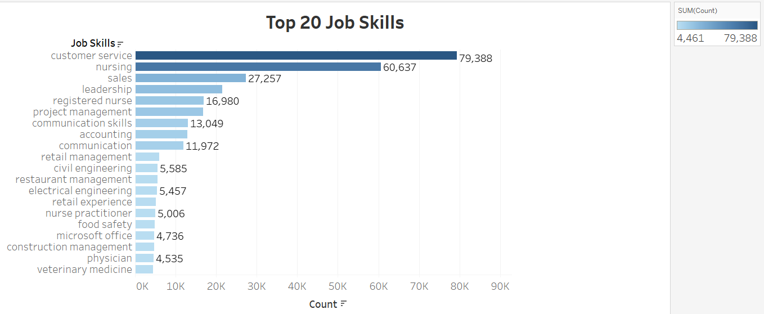
Customer service and nursing are the most sought-after skills, dominating job postings with over 60,000 listings each.
Key Insight: Soft skills like communication and leadership consistently appear alongside technical expertise, reflecting the need for well-rounded professionals.
Notes:
Latika

Slide 9
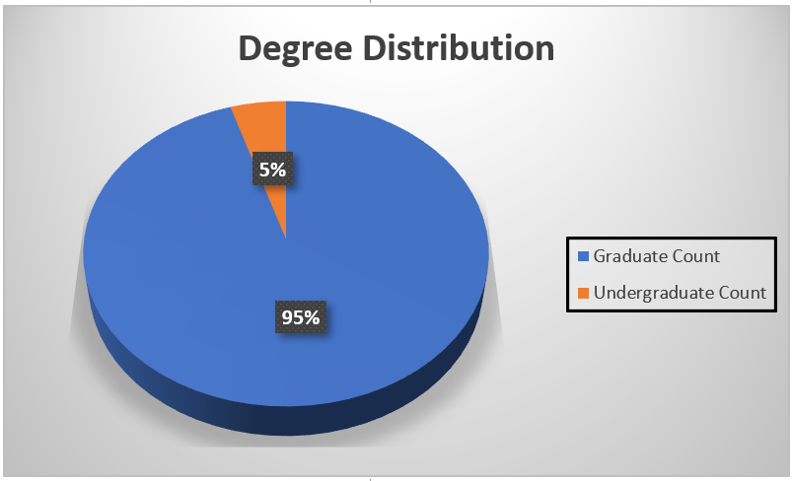
Graduate Degree Jobs - 95% of available roles require a graduate degree Undergraduate Degree Jobs - 5% of available roles require an undergraduate degree Key Insights - Most jobs require advanced education, especially graduate degrees.
Notes:
Latika

Slide 10
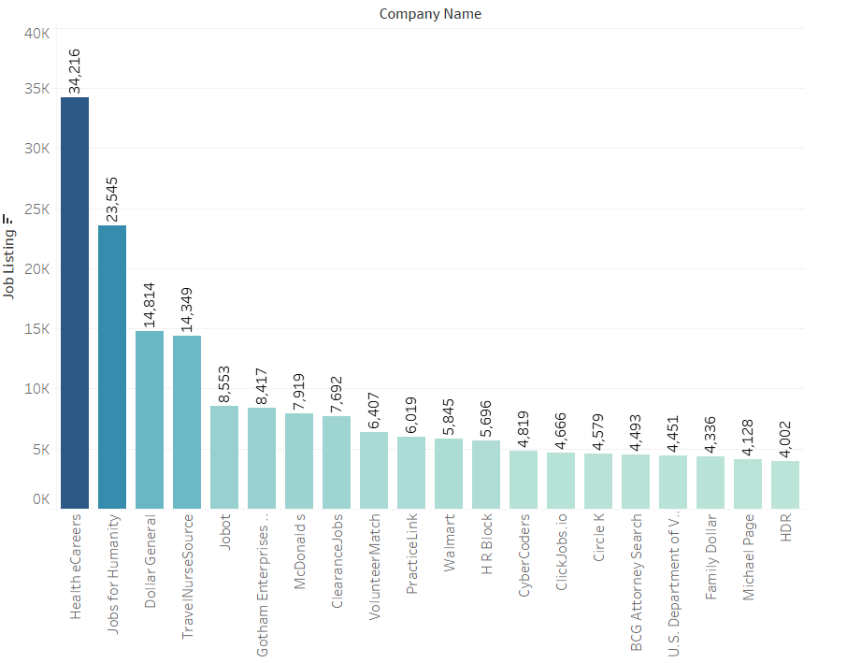
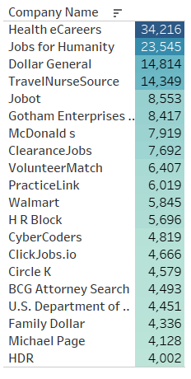
Top 20 Companies with the Most Job Postings
Top Companies by Job Listings: Health eCareers leads with 34,216 postings, followed by Jobs for Humanity at 23,545. Dollar General and TravelNurseSource also feature prominently.
Diverse Industry Representation: McDonald's, Walmart, and Family Dollar contribute to the diverse representation across sectors.
Varied Job Opportunities: From retail to healthcare, companies like Dollar General and TravelNurseSource offer a wide range of positions.
Notes:
Mitali Introduces the Data
Highlights the top companies that have the most job postings in the United States
Derek then introduces the reason behind showing the top 20 companies even though they are all not directly related to prestigious tech companies
They will always need:
Data management
IT Support
Cyber Security
App Developers

Slide 11
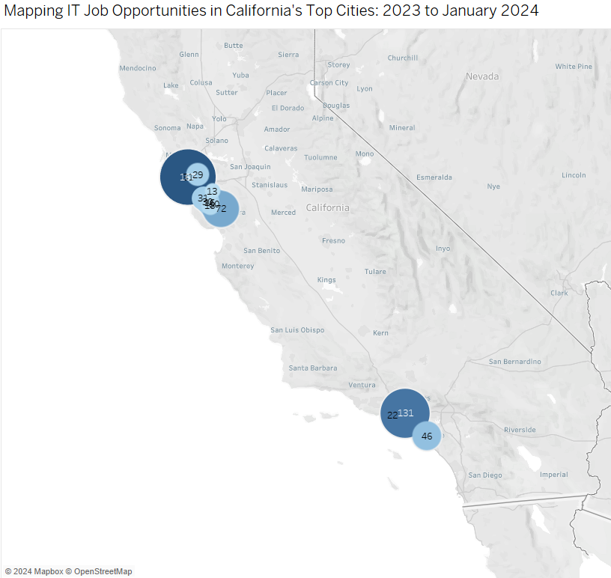

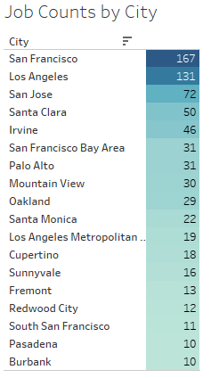


Top California Cities for IT Careers 2023 to January 2024
San Francisco Tops California Cities with the Most IT Job Opportunities: 2023 to January 2024.
Los Angeles Ranks Second for IT Job Opportunities in California: 2023 to January 2024.
Between Northern and Southern California, the Bay Area/Northern California Leads in IT Job Opportunities from 2023 to January 2024.
Notes:
The cities we included in the query are: San Francisco, Los Angeles, San Jose, Santa Clara, Cupertino, Santa Monica, Burbank, Venice, Oakland, South San Francisco, Redwood City, Mountain View, Fremont, Palo Alto, Sunnyvale, Pasadena, Irvine.

Slide 12
CONCLUSION
Data Analysis Insights: Through rigorous measurement, analysis, and comparison of the 1.3 million LinkedIn Jobs & Skills dataset. This analysis has identified the top cities and areas in California where the highest concentration of IT jobs are located.
Strategic Decision Support: These insights offer a critical foundation for informed decision-making, guiding students as they navigate the evolving job market. Highlighting the most in-demand skills and the companies that are hiring the most.
Actionable Visualizations: Our visualizations provide comprehensive insights across multiple dimensions.
They highlight the top job skills prevalent across all industries.
They emphasize the competitive edge a graduate degree offers in the job market through degree distribution analysis.
Revealing the top 20 companies with the most job postings to identify industries that are hiring aggressively.
Additionally, we showcase a map of the top California cities hiring for IT positions. This map directs students on where to concentrate their job searches to find the best opportunities in their field.
Notes:
Needs to be re-written
Mitali – Data Analysis Insights and Strategic Decision Support
Derek – Actionable Visualizations and Continuous Adaptation
Our visualizations provide comprehensive insights across multiple dimensions: They highlight the top job skills prevalent across all industries, emphasize the competitive edge a graduate degree offers in the job market through degree distribution analysis, reveal the top 20 companies with the most job postings to identify industries that are hiring aggressively, and showcase a map of the top California cities. This map guides students on where to focus their job searches for optimal opportunities in their field.

Slide 13


THANK YOU
Questions?
GitHub Link - Click Here

